Slide 1
Tech-Refresh Test Strategy
Commitment to deliver software that matters

Slide 2
Introduction
This document describes high level “BDD Process strategy” for Tech Refresh project to achieve BDD as process implementation in Travelex, including :
Problems and it’s impact in existing process
Current and proposed BDD process
Current and proposed release cycle
Test pyramid roadmap
Phase vise BDD transformation roadmap and mapping

Slide 3
Problems and Impact in existing process
Problems | Impact
Functional automation and its automation is not done within Sprint | Automation issues found later, thereby costly
UAT is done my Business manually | Extra environment is maintained for UAT
No estimation of in-sprint automation is done, it is taken separately | Extra planning effort, and delayed quality assurance to production
Team is only acknowledged to what, not why | Team is not aligned to think in terms of business

Slide 4
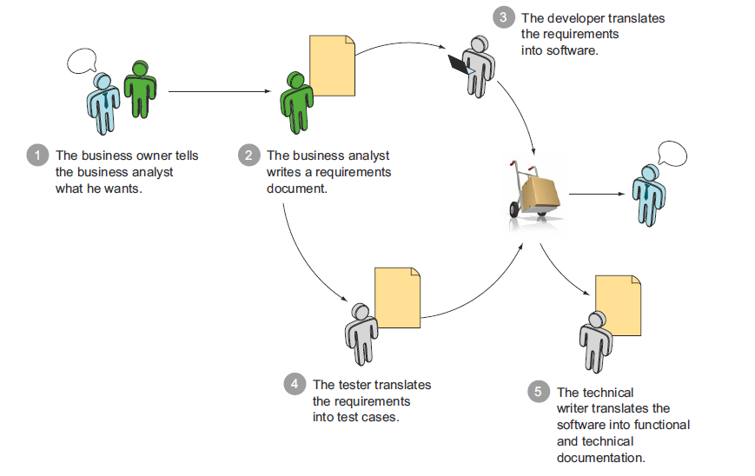
Current Process in Tech-Refresh

Slide 5
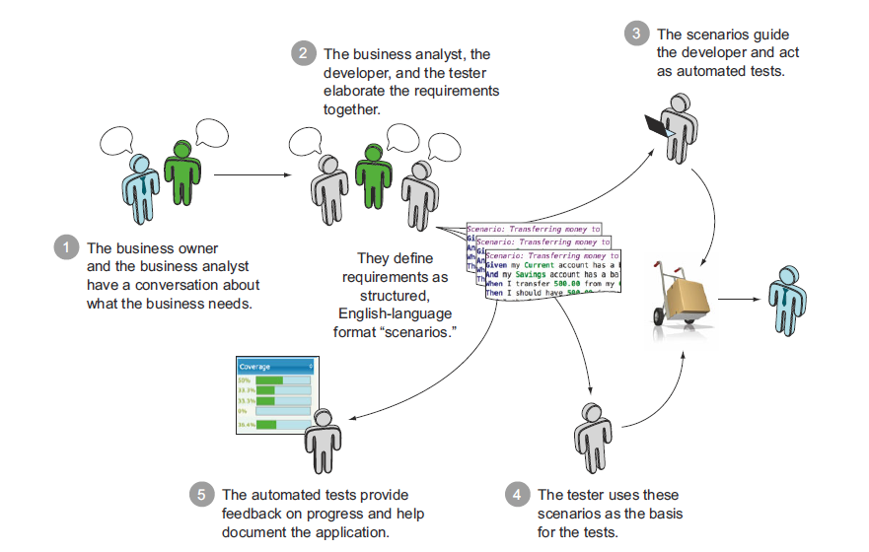
Proposed BDD Process in Tech-Refresh

Slide 6
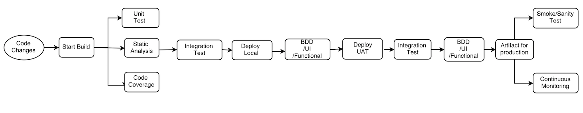
Ideal Release Cycle
CI Integrated test cycle, excluding Performance and Security

Slide 7
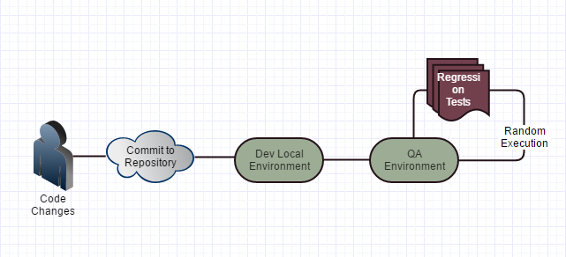
Current Release Cycle

Slide 8
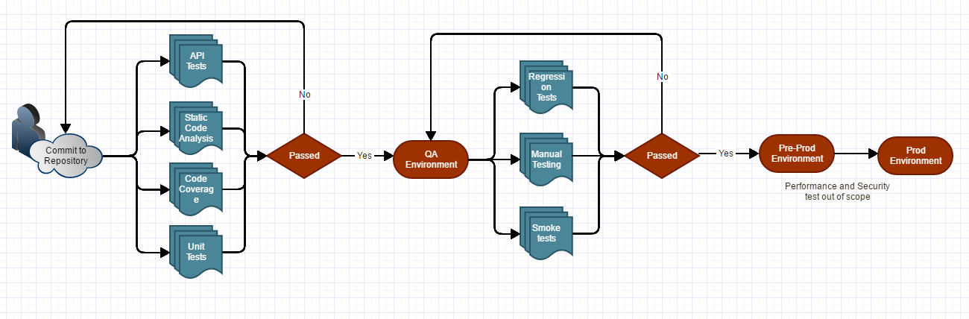
Release Cycle proposed

Slide 9
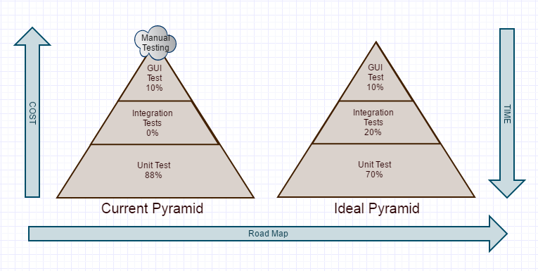
Ideal Vs Tech Refresh Test Pyramid

Slide 10
BDD implementation roadmap
Phase 1 - Sprint 1 | Phase 2 - Sprint 2 & 3 | Phase 3 - Sprint 4
1. BDD process training for the entire team 2. Highlight the roles and responsibilities of Dev, QA and BA as part of BDD implementation 3. Dev and QA to understand requirements directly from BA's 4. Identify cases for regression automation and identify smoke and acceptance tests 5. Take partial in-sprint automation/partial pending tasks 6. Join the sprint and pair within team members 7. Acknowledge all the problems and queries 8. Clear the goal explaining the strategy of BDD implementation 9. Gap analysis for BDD implementation 10. Acknowledge BA with format of writing test 11. Live In-Sprint Feature file for BA, QA and Dev | 1. Demos to happen on Feature file reports and not exact executions to BA 2. Dev to go with drop points approach for smoother delivery 3. Testers get enough time to test 4. Finalize the branching and CI pipeline 5. Tagging regression cases 6. Emphasize BA, QA and Dev's for best practices 7. Formulate the business readable text using ubiquitous language 8. BA is acknowledged with automated test reports 9. Continuous monitoring of test pyramid and test reports 10. Integration of unit test, code coverage, static analysis and api test in CI pipeline | 1. Bug fixes also automated 2. Integrate entire process in CI pipeline and reporting 3. Testers focus on automated test rather than Manual tests 4. BA/End user in agreement to reduce/automate UAT cycles 5. Writing corner cases within scenario 6. Regression to be added to regression suite 7. Executing sprint changes target automation 8. Brainstorming with BA in writing scenario examples for understanding business goals 9. Validate the outcomes of BDD

Slide 11
BDD implementation mapping
Parameters | Phase 1 – week 1 | Phase 2- week 2 and 3 | Phase 3- week 4
Test Pyramid | Unit test = 88% Integration test = 0% GUI tests = 100% | Unit test > 90% Integration test= 5% GUI tests = 100% | Unit test > 90% Integration test > 20% GUI tests = 100%
Execution Time | 6hrs < | 6hrs < | 6hrs <
Test Resource utilization | Sprint N-1, 50% effort/Sprint N, 50% effort | Sprint N-1, 60% effort/Sprint N, 40% effort | N
Defects | 10% increment | 20% increment | 40% increment
Throughput | -20% | -5 | 10
BA Manual % Validation | As is,100% Manual | 60% Manual | 30% manual
V&V Environment Readiness | 1. Plan of tests execution in CI 2. 100% success report triggers deployment | Automated test execution for: a. Unit Tests b. Static Code Analysis c. Code Coverage | Automated execution for: a. Integration/API tests b. Functional Tests

Slide 12
Security / Performance Left Shit approach I
Performance/Security testing is part of Definition of Done
Development activity stops before the sprint ends
The performance/Security testing is done only for individual features by feature sprint teams.
Performance testing is not done at the system level.

Slide 13
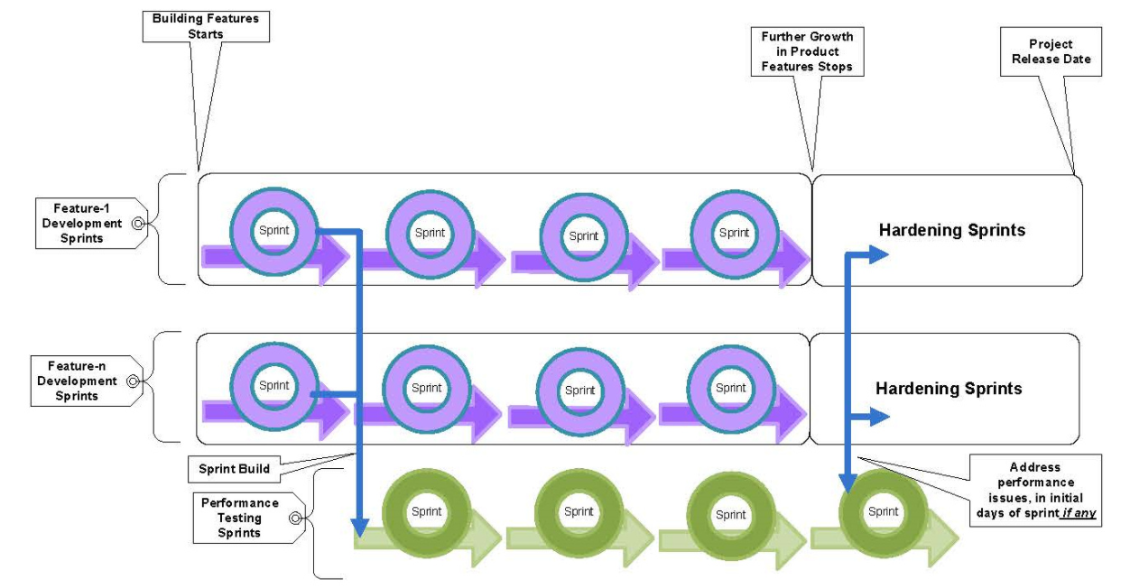
Security / Performance Left Shit approach II

Slide 14
Security / Performance Left Shit approach II
Conduct a separate sprint team consisting of performance/Security test engineers.
This team takes the sprint build that got released in the previous sprint.
The team continued to perform performance /Security testing at the feature level and system level as and when the features were developed and added to the system in every sprint.
Any issues related to performance /Security were addressed in the subsequent sprints.
The team completed the reliability testing in between, with the initial features to address early being issues on reliability, and continued as and when features were added to the system.
The project had scheduled, additional sprints called "hardening sprints" before the actual release of the product.

Slide 15
Assumptions
Team are already practising Agile with stories groomed
BA’s writing stories with clear acceptance criteria
Team Tech Refresh is available during all the phases of transformation
Team is open for accepting changes and recommendation
We get all the environments provisioned including QA, DEV and PRE-PROD
Performance SLAs are defined

Slide 16
Questions ??
Thank You
amitkumar@xebia.com
amit.kumar2@travelex.com

